Slide 1


Regular Expressions (RegEx)
Regular Expressions Language Syntax
SoftUni Team
Technical Trainers
Software University
http://softuni.bg

Slide 2
Table of Contents
Regular Expressions Syntax
Definition and Pattern
Predefined Character Classes
Quantifiers and Grouping
Backreferences
Regular Expressions in C#

Slide 3
Have a Question?
sli.do
#fund-csharp

Slide 4
[A-Z]
Regular Expressions
Definition and Classes

Slide 5
What are Regular Expressions?
Regular expressions (regex)
Match text by pattern
Patterns are defined by special syntax, e.g.
[0-9]+ matches non-empty sequence of digits
[A-Z][a-z]* matches a capital + small letters
Play with regex live at: regexr.com, regex101.com

Slide 6
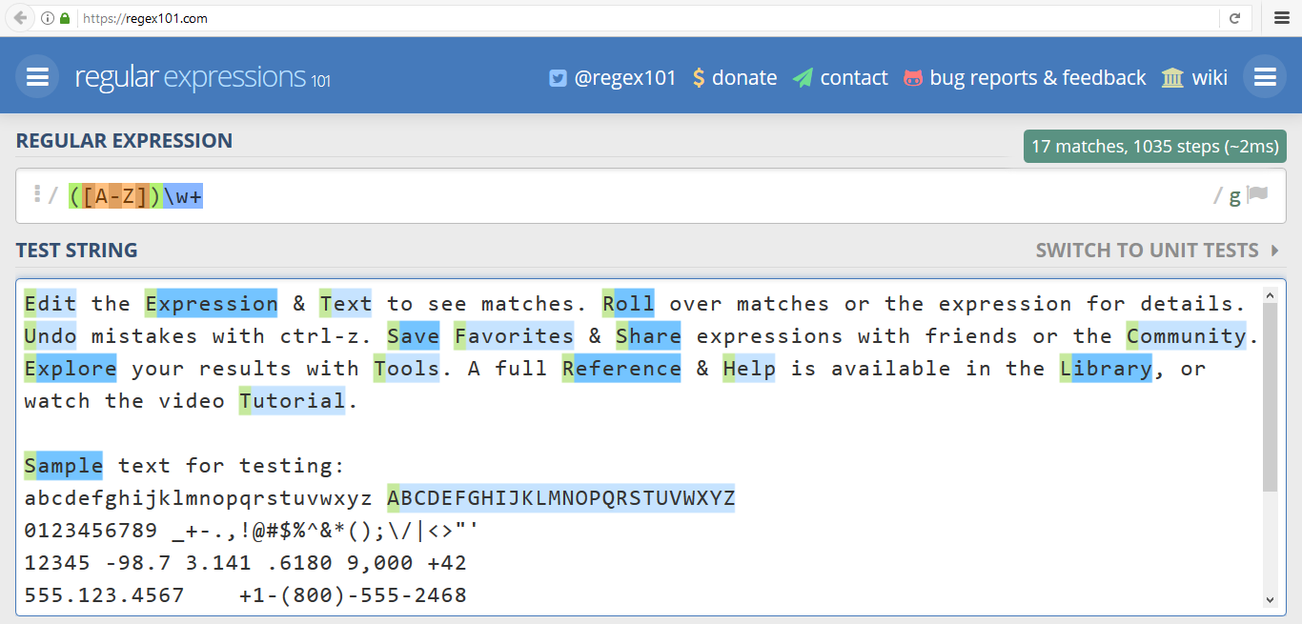
www.regex101.com
Live Demo

Slide 7
Regular Expression Pattern – Example
Regular expressions (regex) describe a search pattern
Used to find / extract / replace / split data from text by pattern
[A-Z][a-z]+ [A-Z][a-z]+
John Smith
Linda Davis
Contact: Alex Scott

Slide 8
Character Classes: Ranges
[nvj] matches any character that is either n, v or j
[^abc] – matches any character that is not a, b or c
[0-9] – character range: matches any digit from 0 to 9
node.js v0.12.2
Abraham
John is 8 years old.

Slide 9
Predefined Classes
\w - matches any word character (a-z, A-Z, 0-9, _)
\W - matches any non-word character (the opposite of \w)
\s - matches any white-space character
\S - matches any non-white-space character (opposite of \s)
\d - matches any decimal digit (0-9)
\D - matches any non-decimal character (the opposite of \d)

Slide 10
(\w+)
Quantifiers
Grouping

Slide 11
Quantifiers
* - matches the previous element zero or more times
+ - matches the previous element one or more times
? - matches the previous element zero or one time
{3} - matches the previous element exactly 3 times
\+\d*
+359885976002 a+b
\+\d+
+359885976002 a+b
\+\d?
+359885976002 a+b
\+\d{3}
+359885976002 a+b

Slide 12
Grouping Constructs
(subexpression) - captures the matched subexpression as numbered group
(?:subexpression) - defines a non-capturing group
(?<name>subexpression) - defines a named capturing group
\d{2}-(\w{3})-\d{4}
22-Jan-2015
^(?:Hi|hello),\s*(\w+)$
Hi, Peter
(?<day>\d{2})-(?<month>\w{3})-(?<year>\d{4})
22-Jan-2015

Slide 13
Problem: Match All Words
Write a regular expression in www.regex101.com that extracts all word char sequences from given text
_ (Underscores) are also word characters!
_|Underscores|are|also|word|characters

Slide 14
Problem: Match Dates
Write a regular expression that extracts dates from text
Valid date format: dd-MMM-yyyy
Examples: 12-Jun-1999, 3-Nov-1999
I am born on 30-Dec-1994.
My father is born on the 9-Jul-1955.
01-July-2000 is not a valid date.

Slide 15
Problem: Email Validation
Write a regular expression that performs simple email validation
An email consists of: username @ domain name
Usernames are alphanumeric
Domain names consist of two strings, separated by a period
Domain names may contain only English letters
Valid:
Invalid:
valid123@email.bg
invalid*name@emai1.bg

Slide 16
\1
Backreferences
Numbered Capturing Group

Slide 17
Backreferences Match Previous Groups
\number - matches the value of a numbered capture group
<(\w+)[^>]*>.*?<\/\1>
<b>Regular Expressions</b> are cool!
<p>I am a paragraph</p> … some text after
Hello, <div>I am a<code>DIV</code></div>!
<span>Hello, I am Span</span>
<a href="https://softuni.bg/">SoftUni</a>

Slide 18
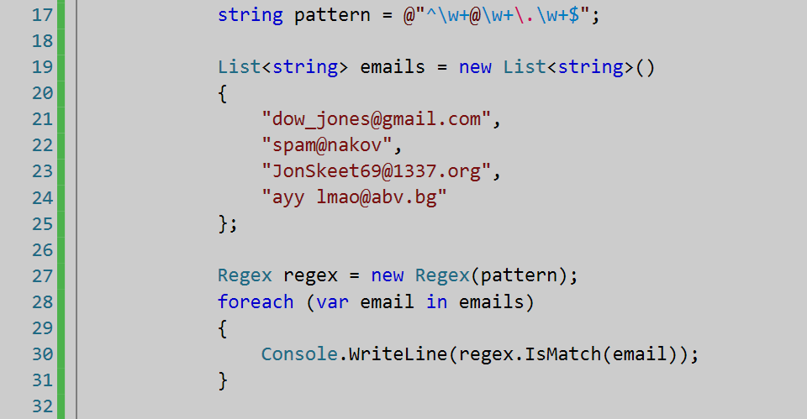
Regular Expressions
Using .NET Built-In Regex Classes

Slide 19
Regex in C#
C# supports a built-in regular expression class: Regex
Located in System.Text.RegularExpressions namespace
using System.Text.RegularExpressions;
static void Main()
{
string pattern = @"A\w+";
Regex regex = new Regex(pattern);
}

Slide 20
Validating String By Pattern
IsMatch(string text)
Determines whether the text matches given pattern
string text = "Today is 2015-05-11";
string pattern = @"\d{4}-\d{2}-\d{2}";
Regex regex = new Regex(pattern);
bool containsValidDate = regex.IsMatch(text);
Console.WriteLine(containsValidDate); // True

Slide 21
Checking for a Single Match
Match(string text)
Returns the first match of given pattern
string text = "Nakov: 123";
string pattern = @"([A-Z][a-z]+): (\d+)";
Regex regex = new Regex(pattern);
Match match = regex.Match(text);
Console.WriteLine(match.Groups.Count); // 3
Console.WriteLine("Matched text: \"{0}\"", match.Groups[0]);
Console.WriteLine("Name: {0}", match.Groups[1]); // Nakov
Console.WriteLine("Number: {0}", match.Groups[2]); // 123

Slide 22
Checking for Matches
Matches(string text) - returns a collection of matches
string text = "Nakov: 123, Branson: 456";
string pattern = @"([A-Z][a-z]+): (\d+)";
Regex regex = new Regex(pattern);
MatchCollection matches = regex.Matches(text);
Console.WriteLine("Found {0} matches", matches.Count);
foreach (Match match in matches)
Console.WriteLine("Name: {0}", match.Groups[1]);
// Found 2 matches
// Name: Nakov
// Name: Branson

Slide 23
Replacing With Regex
Replace(string text, string replacement) - replaces all strings that match the pattern with the provided replacement
string text = "Nakov: 123, Branson: 456";
string pattern = @"\d{3}";
string replacement = "999";
Regex regex = new Regex(pattern);
string result = regex.Replace(text, replacement);
Console.WriteLine(result);
// Nakov: 999, Branson: 999

Slide 24
Splitting With Regex
Split(string text) - splits the text by the pattern
Returns string[]
string text = "1 2 3 4";
string pattern = @"\s+";
string[] results = Regex.Split(text, pattern);
Console.WriteLine(string.Join(", ", results));
// 1, 2, 3, 4

Slide 25
Problem: Match Full Name
You are given a list of names
Match all full names
Ivan Ivanov, Ivan ivanov, ivan Ivanov, IVan Ivanov, Test Testov, Ivan Ivanov
Ivan Ivanov Test Testov
Check your solution here: https://judge.softuni.bg/Contests/1667/Regular-Expressions-Lab

Slide 26
Solution: Match Full Names
string listOfNames = Console.ReadLine();
string pattern @"\b[A-Z][a-z]+ [A-Z][a-z]+";
Regex regex = new Regex(pattern);
MatchCollection validNames = regex.Matches(input); foreach (Match name in validNames)
{
Console.Write($"{name.Value} ");
}
Console.WriteLine();
Check your solution here: https://judge.softuni.bg/Contests/1667/Regular-Expressions-Lab
Notes:
You can try also: @"<a.*href=((?:.|\n)*?(?=>))>((?:.|\n)*?(?=<))<\/a>"

Slide 27
Problem: Match Dates
You are given a string
Match all dates in the format "dd{separator}MMM {separator}yyyy" and print them space-separated
13/Jul/1928, 01/Jan-1951
Day: 13, Month: Jul, Year: 1928
Check your solution here: https://judge.softuni.bg/Contests/1667/Regular-Expressions-Lab

Slide 28
Solution: Match Dates
string input = Console.ReadLine();
string pattern = @"\b(?<day>\d{2})(\.|-|\/) (?<month>[A-Z][a-z]{2})\1(?<year>\d{4})\b";
MatchCollection matches = Regex.Matches(input, pattern);
foreach (Match date in matches)
Console.WriteLine($"Day: {date.Groups["day"].Value}, Month: {date.Groups["month"].Value}, Year: {date.Groups["year"].Value}");
Check your solution here: https://judge.softuni.bg/Contests/1667/Regular-Expressions-Lab
Notes:
You can try also: @"<a.*href=((?:.|\n)*?(?=>))>((?:.|\n)*?(?=<))<\/a>"

Slide 29

Summary
…
…
…
Regular expressions describe patterns for searching through text
Define special characters, operators and constructs for building complex pattern
Can utilize character classes, groups, quantifiers and more

Slide 30
https://softuni.bg/courses/technology-fundamentals

Slide 31












SoftUni Diamond Partners

Slide 32





SoftUni Organizational Partners

Slide 33




Trainings @ Software University (SoftUni)
Software University – High-Quality Education and Employment Opportunities
softuni.bg
Software University Foundation
http://softuni.foundation/
Software University @ Facebook
facebook.com/SoftwareUniversity
Software University Forums
forum.softuni.bg

Slide 34

License
This course (slides, examples, demos, videos, homework, etc.) is licensed under the "Creative Commons Attribution-NonCommercial-ShareAlike 4.0 International" license

